Slide 1
Linux Workshop
CSI

Slide 2
What is Linux
A family of Free Operating Systems
Available in various flavors, each suitable for a particular type of application
(Kali for Penetration Testing, Red Hat for Enterprise Workload, Ubuntu for Beginners)
Ubuntu is a Debian-Based OS
Some Linux-Specific Features-
Live CD/USB: Almost all Linux distros provide live CD/USB so that users can run/try it without installing it.
Open Source: Linux code is freely available to all and is a community based development project.

Slide 3
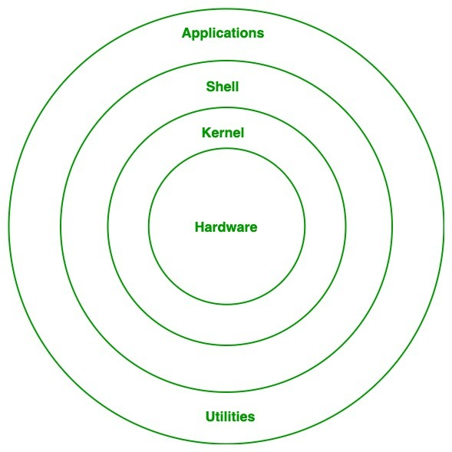
Linux Architecture
Hardware Layer: This layer consists all peripheral devices like RAM/ HDD/ CPU etc.
Kernel: Kernel is the core of the Linux based operating system. It virtualizes the common hardware resources of the computer to provide each process with its virtual resources. This makes the process seem as if it is the sole process running on the machine. The kernel is also responsible for preventing and mitigating conflicts between different processes.
System Library: Is the special types of functions that are used to implement the functionality of the operating system.
Shell: It is an interface to the kernel which hides the complexity of the kernel’s functions from the users. It takes commands from the user and executes the kernel’s functions.
System Utility: It provides the functionalities of an operating system to the user.

Slide 4
Linux File System
In Linux, the file system creates a tree structure.
Linux treats everything as a file. Including directories.
Features:
Linux does not use the backslash (\) to separate the components; it uses forward slash (/) as an alternative.
In Linux, a file may have the extension '.txt,' but it is not necessary that a file should have a file extension.
Hidden files in Linux are represented by a dot (.) before the file name (ex: .bash_history).

Slide 5
Special Directories
The entire Linux directory structure starting at the top (/) root directory.
The root filesystem is the top-level directory of the filesystem.
It must contain all of the files required to boot the Linux system before other filesystems are mounted.
It must include all of the required executables and libraries required to boot the remaining filesystems.
The /root/ folder (aforementioned root “directory” is just / ) acts as the /home/ for the superuser (su)
/boot: Contains the static bootloader and kernel executable and configuration files required to boot a Linux computer.

Slide 6
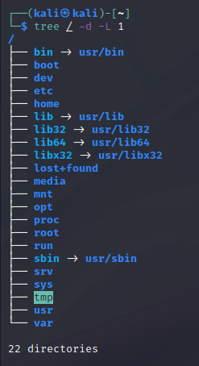
(continued)
/tmp Temporary directory. Used by the operating system and many programs to store temporary files.
/var Variable data files are stored here. This can include things like log files, MySQL, and other database files, web server data files, email inboxes, and much more.
/usr These are shareable, read-only files, including executable binaries and libraries, man files, and other types of documentation.
/etc Contains the local system configuration files for the host computer.

Slide 7
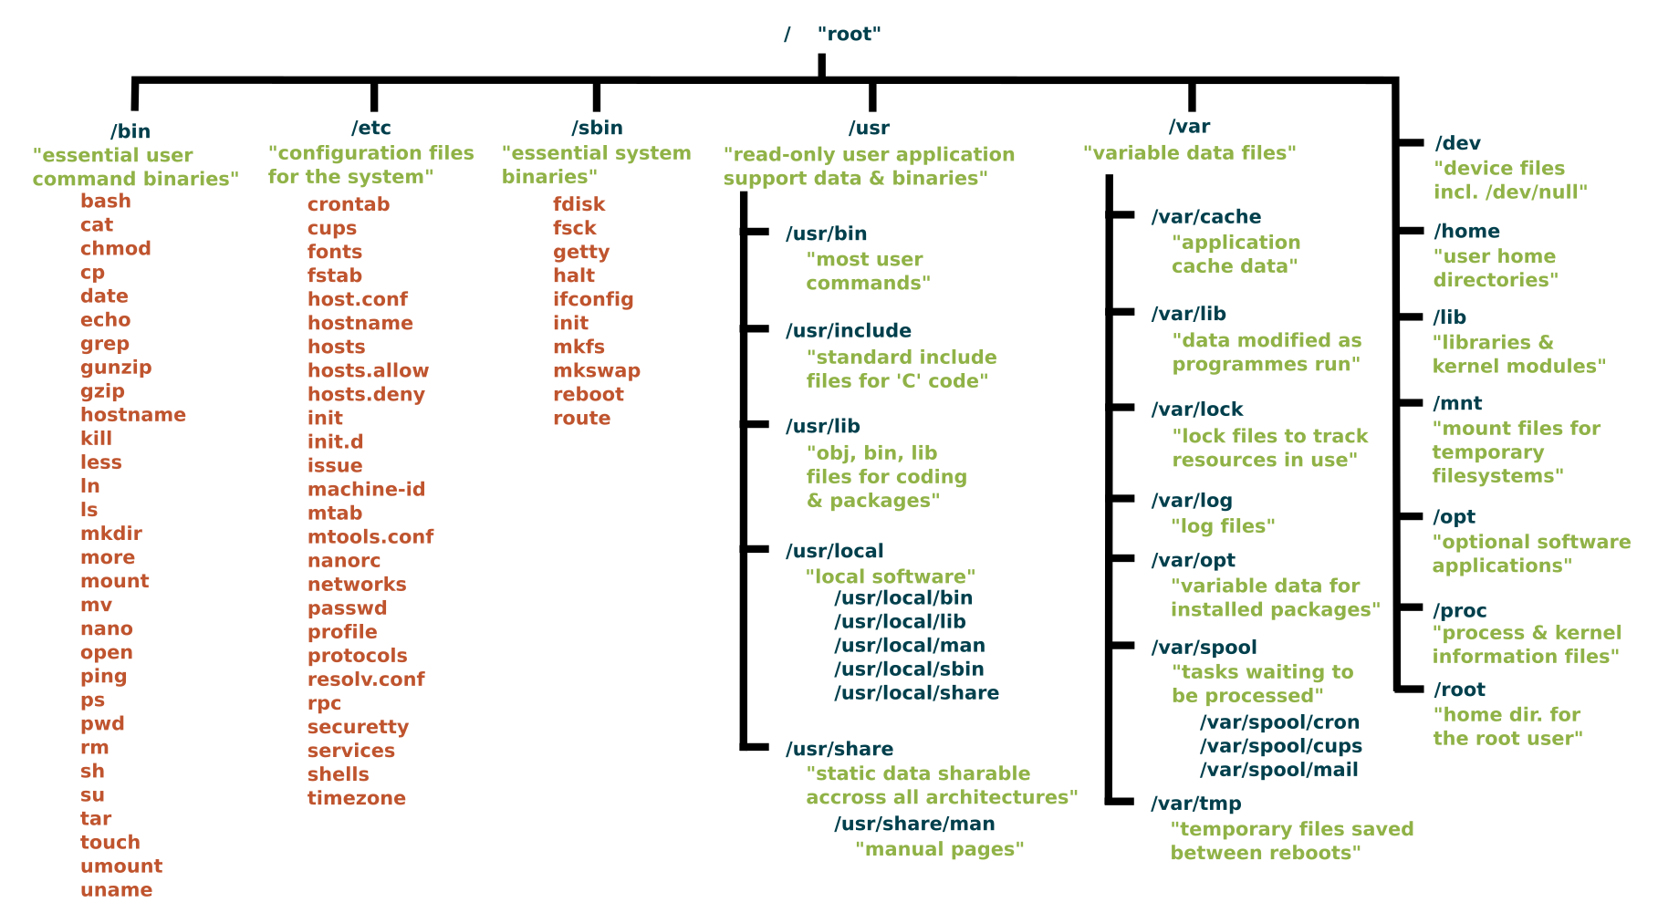

Slide 8
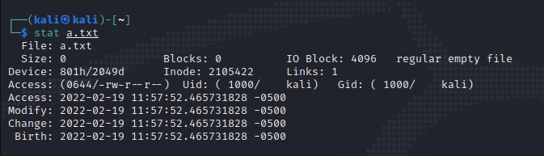
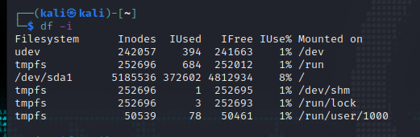
iNodes (not-really-from-Apple)
Every Linux file or directory has an inode, and this inode contains all of the file’s metadata.
Every Node on the File tree has an unique inode number
Inode number is also known as index number.
An inode is a unique number assigned to files and directories while it is created. The inode number will be unique to entire filesystem.

Slide 9


File Permissions
There are three characters: x for Executable, R for Read and W for Write
These permissions are part of the file metadata (Even directories have permissions)
(ls –l will display this)
First character is reserved for Special bits (here d is for directory) (similarly “l” represents File Links, and “t”/”u” are SUID/SGID/Sticky bits)
The Cyan Box has permissions for the Owner of that particular file
The Red Box has permissions for the Group that owner-user is a part of
The Yellow Box is the permissions given to everyone
{file permissions} {number of hardlinks} owner group

Slide 10
Using Binary to Set Permissions
The first number represents the Owner permission; the second represents the Group permissions; and the last number represents the permissions for all other users. The numbers are a binary representation of the rwx string.
r = 4
w = 2
x = 1
Add the Numbers and assign it using chmod
So- chmod 740 <file> would give RWX (4+2+1) to the Owner, only Read Permissions to the group and 0 (No) Permission for the other users on system

